Slide 1


Comparing React Native With Top Mobile Development Frameworks
Mobile app development has evolved dramatically, with cross-platform frameworks becoming increasingly popular for businesses seeking efficiency without sacrificing quality. This presentation explores how React Native compares to Flutter, Xamarin, Ionic, and Swift.
We'll examine key factors including programming languages, performance metrics, UI component approaches, and developer experience across these leading frameworks to help you make informed decisions for your next mobile development project.

Slide 2

What Is React Native?
1
Cross-Platform Development
2
JavaScript Foundation
Built on JavaScript and React, this framework leverages existing web development skills, making it accessible to a wide pool of developers without requiring platform-specific expertise.
React Native enables developers to write one codebase that runs on both iOS and Android platforms, significantly reducing development time and maintenance costs while maintaining a native feel.
3
Native Components
Unlike hybrid approaches, React Native interfaces with actual platform UI components rather than web views, resulting in applications that look and behave like they were built specifically for each platform.

Slide 3
React Native vs Flutter: Language & Performance
React Native
Flutter
Uses JavaScript and React, making it highly accessible to web developers. This familiar syntax significantly reduces the learning curve for teams transitioning to mobile development.
Built on Google's Dart language, which has a steeper learning curve for most developers but offers strong typing and object-oriented features that appeal to Java and C# developers.
Performance can be a concern due to the JavaScript bridge that translates code to native instructions, potentially creating bottlenecks in complex applications with heavy animations.
Provides superior performance by compiling directly to native ARM code. This approach eliminates the bridge bottleneck, making Flutter particularly effective for animation-heavy applications and games.

Slide 4

React Native vs Flutter: UI & Development Experience
Aspect
React Native
Flutter
UI Components
Uses platform-specific native components, creating authentic iOS/Android look and feel
Custom widget system with its own rendering engine, allowing highly customizable UIs but potentially less native feel
Hot Reload
Supported, allowing real-time code changes without full recompilation
Supported, with similar development speed benefits
Maturity
Established ecosystem with extensive libraries and community support
Growing ecosystem with strong Google backing, but fewer third-party packages

Slide 5




React Native vs Xamarin: Language & Performance
React Native: JavaScript
Xamarin: C#
Performance Comparison
Built on C# and .NET, making it ideal for developers in the Microsoft ecosystem but potentially creating a higher barrier of entry for those without this background.
Utilizes JavaScript and React, making it accessible to web developers and those familiar with front-end development. The large JavaScript ecosystem means abundant resources and libraries.
React Native offers good performance for most applications but can struggle with complex animations. Xamarin compiles to native code, often delivering superior performance in resource-intensive scenarios.

Slide 6

React Native vs Xamarin: UI & Development Experience
1
UI Approach
React Native leverages native UI components directly, ensuring applications have an authentic platform-specific look and feel with minimal additional configuration required.
2
Xamarin Options
Offers Xamarin.Forms for shared UI across platforms with less customization or Xamarin.iOS/Xamarin.Android for platform-specific development with greater control but less code sharing.
3
Development Tools
React Native provides a lightweight development environment with hot reloading for rapid iteration. Xamarin integrates deeply with Visual Studio, offering robust tooling but sometimes slower build and deployment processes.
4
Community Support
React Native enjoys stronger community support and more third-party libraries. Xamarin has solid Microsoft backing but a smaller community and fewer ready-made solutions.

Slide 7




React Native vs Ionic: Technology Approach
Language Base
Rendering Method
Both frameworks use JavaScript, but Ionic typically incorporates Angular, React, or Vue to build hybrid apps running in WebViews.
React Native converts JavaScript to native UI components, while Ionic renders through browser-based WebViews.
1
2
Performance Impact
Native Access
The WebView approach in Ionic creates an additional layer between code and device, potentially reducing performance compared to React Native.
React Native provides direct access to native APIs, while Ionic requires plugins like Capacitor or Cordova to access native features.
4
3

Slide 8

React Native vs Ionic: Developer Experience & Use Cases
Ideal Use Cases for React Native
Applications requiring near-native performance and user experience, including most business apps, social networks, and content-driven applications with moderate animation needs.
Ideal Use Cases for Ionic
Content-focused applications with minimal animation requirements, internal enterprise apps, or rapid prototyping where development speed outweighs performance concerns.
React Native Development Flow
Offers hot reloading for instant feedback during development, with a comprehensive ecosystem of tools and libraries. The learning curve is moderate for JavaScript developers.
Ionic Development Flow
Extremely accessible for web developers with minimal learning curve. The WebView approach allows direct use of web development skills but imposes limitations on native functionality and performance.

Slide 9
React Native vs Swift: Native iOS Development
Platform Coverage
1
React Native covers iOS and Android with one codebase, while Swift is exclusively for Apple platforms.
Performance Ceiling
2
Swift offers unmatched performance on iOS with direct compilation to native code and no intermediary layers.
Development Speed
3
React Native enables faster cross-platform development compared to maintaining separate Swift and Android codebases.
While Swift provides the best possible performance for iOS applications, its platform-specific nature means developers must maintain a completely separate codebase for Android, significantly increasing development and maintenance costs for cross-platform projects.
React Native sacrifices some performance optimization but delivers substantial time and resource savings by maintaining a single codebase that works across platforms.

Slide 10
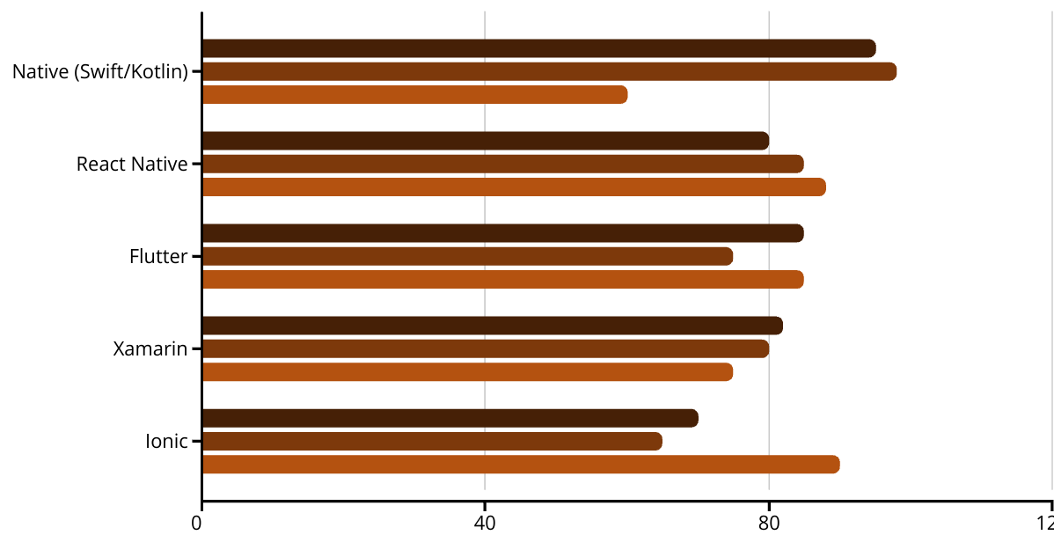
Framework Comparison: Key Metrics
Performance
UI Authenticity
Dev Speed
This comparison illustrates the trade-offs between development frameworks. While native development with Swift/Kotlin delivers superior performance and authenticity, it comes at the cost of development speed. React Native strikes a balanced approach across all metrics, making it suitable for most business applications.

Slide 11








When to Choose Each Framework
React Native
Flutter
Xamarin
Swift/Native
Best for cross-platform projects requiring native feel without extreme performance demands. Ideal for business applications, social networks, and content-focused apps when development speed is important.
Optimal for visually rich applications with custom UIs and heavy animations. Perfect when performance matters more than platform-specific UI conventions.
Well-suited for enterprise applications within Microsoft ecosystems. Excellent when C# expertise is available and deep integration with Windows environments is needed.
The right choice when maximum performance and platform-specific features are critical, or when developing exclusively for iOS with no Android requirement.

Slide 12





Key Takeaways
Balance
1
React Native offers the best balance of development speed, performance, and native experience
2
Ecosystem
Strong community support and rich library ecosystem enhance development efficiency
3
Efficiency
Single codebase for multiple platforms reduces development and maintenance costs
4
Accessibility
JavaScript foundation makes it accessible to a wide pool of developers
5
Adaptability
Suitable for most business applications without extreme performance demands
React Native has established itself as a leading framework for cross-platform mobile development by striking an effective balance between development efficiency and application performance. While each framework has specific strengths, React Native's combination of JavaScript accessibility, strong community support, and native component integration makes it a compelling choice for most business applications.

